Slide 1
BLOCKCHAIN TECHNOLOGY
AN OVERVIEW
6-JAN-2016

Slide 2

ABOUT ME
Leonard Tan
Digital Consultant
DDP in BSc(Econs) and BBM(Finance) @ SMU
Hack Reactor Graduate FintechNews & CoinHako

Slide 3


OVERVIEW
Blockchains
A technical explanation
Emerging Technology
Bitcoin 2.0
Industry Trends
Risks and responses
Future Direction
A blockchain strategy
Distributed ledger
Transaction Structure
Blockchain Structure
Nodes
Summary
Smart Contracts
Anonymous transactions
Tokens
Off-chain transactions
Sidechains
Scalability
Centralisation
Regulation
Bitcoin vs Altcoins
Peripheral services
Public vs private blockchains
Blockchain consultants
Strategic positioning
Conclusion

Slide 4
Blockchains
a technical explanation
Distributed ledger
Transaction structure
Blockchain structure
Nodes
Summary

Slide 5


Distributed Ledgers
A digital ledger is a digital record of who owns what
A distributed digital ledger is a ledger that is replicated among many nodes
The main innovation is the underlying distributed consensus mechanism
I sent $2 to Bob
Alice | Bob
-2 | +2
-5 | +5
+3 | -3
Alice
I sent $5 to Bob
I owe Bob $4
Bob sent $3 to me
Alice sent $2 to me
Alice | Bob
-2 | +2
-5 | +5
+3 | -3
Alice owes me $4
Alice sent $5 to me
Bob
I sent $3 to Alice

Slide 6
Distributed Ledgers
There have been other good algorithms that have been used for distributed consensus
Paxos, PBFT
However, besides distributed consensus, blockchains also:
Scale relatively better than existing consensus algorithms
Compensate for the costs of verifying and generating consensus
Disincentivise attacks
Blockchains work in practice, not theory.

Slide 7
Distributed Ledgers
How are distributed ledgers different from traditional database systems?
Data is completely replicated across all nodes (high redundancy)
Since nodes are untrusted, all data needs to be independently verified
However, the verification process is rather fast
Currently around 50ms/block for the fastest nodes, soon to be ~10ms (bitcoin)
Current blockchain size is 97GB, usually takes more than 1 day to sync

Slide 8
Blockchains
a technical explanation
Distributed ledger
Transaction structure
Blockchain structure
Nodes
Summary

Slide 9
Transaction structure
A transaction is a record that contains inputs and outputs
An input has to reference a previous transaction’s output
In order to do this successfully, the correct key has to be provided
Exception: the very first transaction in a block has no inputs and simply generates a set number of bitcoins for the miner (i.e. miner’s reward)

Slide 10

Transaction structure
transaction
transaction
inputs
outputs
inputs
outputs
transaction
transaction
inputs
outputs
inputs
outputs
transaction
inputs
outputs
transaction
inputs
outputs

Slide 11
Transaction structure
Wallet applications build on top of these simple transactions
To get your current balance, sum up the UTXOs that your keys can unlock
In order to send someone a small input when referencing a large output, create a transaction like this:
Large input → 2 partial outputs
Send one of the outputs back to yourself
Miner fees are implicitly calculated: outputs - inputs

Slide 12
Transaction structure
These simple transactions act as building blocks to more complex transactions
N-of-M multisig
Requires N out of M members to authorise a transaction
Smart contracts
Implemented through an unlocking script
Crowdfunding
Transaction is only properly formatted when enough inputs are added

Slide 13
Blockchains
a technical explanation
Distributed ledger
Transaction structure
Blockchain structure
Nodes
Summary

Slide 14
Blockchain structure
Blocks exist on top of the complex network of transactions
They ensure that:
transactions are formatted and ordered correctly
transactions do not try to double spend
…

Slide 15
Blockchain structure
A typical block looks like this:
{
"size" : 43561,
"version" : 2,
"previousblockhash" :
"00000000000000027e7ba6fe7bad39fafdb5a83caed765f05f8a1b71a1632249",
"merkleroot" :
"5e049f4030e0ab2debb92378f53c0a6e02348aea083f3ab25e1d94ea1155e29d",
"time" : 1388185338,
"difficulty" : 1180923191.25802612,
"nonce" : 4215439401,
"tx" : [
"257e7497fb8bc68491eb2c7b699dbab234831600e7172f0d9e6522c7cf3f6c77",
... transactions omitted ...
"05cfd38f6ae6aa83674cc99e4d75a1458c1172bab84725eda41d018a09176634"
]
}

Slide 16

Blockchain structure
Block hash
Block height
Size
Version
Previous block hash
Time
Difficulty
Nonce
Merkle root
Transactions

Slide 17
Blockchain structure
Genesis Block
Block hash
Block hash
Block hash
Block hash
Block height
Block height
Block height
Block height: 0
Size
Size
Size: 285
Size
Version
Version
Version: 1
Version
Previous block hash
Previous block hash
Previous block hash
Previous block hash
Time
Time
Time
Time: 1231006505
Difficulty
Difficulty
Difficulty: 1
Difficulty
Nonce
Nonce
Nonce
Nonce
Merkle root
Merkle root
Merkle root
Merkle root
Transactions
Transactions
1 transaction
Transactions

Slide 18
Blockchain structure
Properties:
Only the longest chain on the network is accepted
It has the most “proof-of-work”
This can result in competing chains and orphaned blocks
Network consensus can only be overcome by a “51% attack”
Past blocks cannot be easily modified

Slide 19
Blockchain structure
Expensive to compute and form blocks
This makes it difficult for any single adversary to acquire enough computing power to overpower the network: ~$400m a year (mid-2016)
Slow to confirm
Tradeoff between speed of confirmation and number of forks
Incentivises miners to be honest
Miners who do not follow the rules waste computing power

Slide 20
Blockchain structure
Miners get a reward for successfully “mining” a block
Difficulty is always adjusted so that mining rate is constant
Bitcoin: 1 block / 10 mins
Ethereum: 1 block / 15 seconds
The mining reward decreases over time
Note: Since a miner is only incentivised by the block reward of X, they will always try to spend X amount of resources on mining. Increasing mining efficiency will not result in less resources being “wasted” on mining.

Slide 21
Blockchains
a technical explanation
Distributed ledger
Transaction structure
Blockchain structure
Nodes
Summary

Slide 22
Nodes
There are an increasing variety of nodes available
Mainly 3 different kinds of nodes:
Miners
Full nodes
Light nodes

Slide 23
Nodes
Full nodes are nodes that have a record of the entire blockchain
The current size is about 97 GB
Light nodes do not store the blockchain
Typically only store a small number of transactions
Request transaction hashes from other full nodes

Slide 24
Nodes
Miners are full nodes that also try to mine the next block
In order to successfully mine a block, you need to follow a strict protocol
Necessary to have access to the entire blockchain
In theory, miners only really need access to the UTXO pool for verification
In practice, most mining software still require miners to have all the blocks

Slide 25
Blockchains
a technical explanation
Distributed ledger
Transaction structure
Blockchain structure
Nodes
Summary

Slide 26
Summary
Transactions contain inputs and outputs
Inputs always reference a previous output by providing the correct key
Blocks contain transactions and a reference to a previous block
only accepted by the network if the hash is smaller than the target
the chain of blocks is the blockchain
Nodes are either full nodes or light nodes
Full nodes hold the entire blockchain, light nodes do not

Slide 27
Emerging Technology
Bitcoin 2.0
Smart contracts
Anonymous transactions
Tokens
Off-chain transactions
Sidechains

Slide 28
Smart contracts
Smart contracts are conditional payments
If <Event A is true> then <output is valid>
More complex conditions can be created using
Timestamps
External sources of information
References to other contracts
Outputs that are contracts

Slide 29
Smart contracts
Ethereum is a cryptocurrency with Turing-complete smart contracts
They can make very complex calculations
Costs of calculation are fuelled by “gas”
Examples: Augur, DAO

Slide 30
Smart contracts
How is this different from traditional contract settlement?
No central point of control
Increased transparency
Decreased costs of verification
Increased flexibility

Slide 31
Smart contracts
Blockchains have no built-in way of incorporating external information in an untrusted manner
Limits the variety of trustless smart contracts, which are more scalable
Solution: Oracles
A trusted third party supplies external information
Augur’s rating system
Intel’s SoftwareGuard Extensions enabled hardware
Town crier

Slide 32
Emerging Technology
Bitcoin 2.0
Smart contracts
Anonymous transactions
Tokens
Off-chain transactions
Sidechains

Slide 33
Anonymous transactions
Since every transaction needs to reference a previous transaction, bitcoins leave a transaction trail
Using graph analysis, it is possible to discover the person behind the transaction
Especially because of “change” outputs
Solution: Bitcoin laundry
CoinJoin/ZeroCoin

Slide 34
Emerging Technology
Bitcoin 2.0
Smart contracts
Anonymous transactions
Tokens
Off-chain transactions
Sidechains

Slide 35
Tokens
A token is a bitcoin that also represents some other resource
The value of that resource is more than its value in bitcoin
Used for trading and managing real-world assets
Leverages normal bitcoin transactions by adding some metadata
Requires a trusted third party to verify assets
Requires a special node to make sense of token transactions

Slide 36
Tokens
3 step process:
Creation transaction
Transfer transaction
Proof-of-burn (redemption)
Examples: Colored coins/CounterParty

Slide 37
Emerging Technology
Bitcoin 2.0
Smart contracts
Anonymous transactions
Tokens
Off-chain transactions
Sidechains

Slide 38
Off-chain transactions
In order to scale the volume of bitcoin transactions, some people are advocating the use of off-chain transactions
Transactions that happen off the blockchain, but are still secured
Requires some new protocols to be effective (Segwit), but are theoretically feasible today.
Lightning Network

Slide 39




Off-chain transactions
Broadcast to blockchain
Broadcast to blockchain
Alice
2 BTC
1 BTC
2 BTC
4 BTC
4 BTC
Time
0
1
2
3
2 BTC
3 BTC
2 BTC
0 BTC
0 BTC
Bob

Slide 40
Emerging Technology
Bitcoin 2.0
Smart contracts
Anonymous transactions
Tokens
Off-chain transactions
Sidechains

Slide 41
Sidechains
As we have seen in off-chain transactions, you can create side-channels by freezing a set number of bitcoins
Using this feature, we can potentially trade between different blockchains
2-way peg
Examples: Elements Project, Hivemind

Slide 42
Sidechains
Allows future experimentation without affecting the major blockchain’s protocols
Potentially allows for the merging of private blockchains
Will increase the variety of applications and speed of development

Slide 43
BREAK TIME
15 MINUTES

Slide 44
Industry Trends
Risks and responses
Scalability
Centralisation
Regulations
Bitcoin vs Altcoins
Peripheral services

Slide 45
Scalability
VISA handles ~2000 transactions per second (can handle up to 56000 tps)
Bitcoin handles 7 transactions per second
Ethereum can handle 25 transactions per second
Block limits are artificial and can be raised to accommodate more transactions, in theory. However:
The community is divided for many reasons
There are still bandwidth limitations
In order reach VISA-scale, each block would need to be 8GB

Slide 46
Scalability
More likely that we will see off-chain solutions in the near future
Lightning Network/Sidechains
We might also make use of other cryptocurrencies for smaller exchanges of currency
Scalability is the biggest problem that needs to be addressed for cryptocurrency’s viability

Slide 47
Industry Trends
Risks and responses
Scalability
Centralisation
Regulations
Bitcoin vs Altcoins
Peripheral services

Slide 48
Centralisation
Decentralisation is one of the main advantages of blockchain technology and cryptocurrency
However, most cryptocurrencies are still centralised in some way:
Small group of privileged developers (13 people as of Jan 2017)
Reference client
Mining pools
Specialised hardware
Cheap electricity
Government funding

Slide 49
Centralisation
Many of the arguments against certain scaling proposals bring up the idea of unnecessary centralisation
If nodes are allowed to be high-performance, they are no longer accessible to the masses
Off-chain transactions incentivise a hub-and-spoke model of creating channels
Everyone wants to be connected with the most connected person
Not necessarily a bad thing, with the right incentive structures

Slide 50
Industry Trends
Risks and responses
Scalability
Centralisation
Regulations
Bitcoin vs Altcoins
Peripheral services

Slide 51
Regulations
Is it a currency, or is it an asset?
Hashfast Technologies LLC vs Lowe - asset
MAS doesn’t specify that it is a currency - asset?
Should cryptocurrency companies be subject to financial institution regulations (KYC/AML)?
MAS has announced that they want to regulate virtual currency intermediaries for AML and terrorism financing

Slide 52
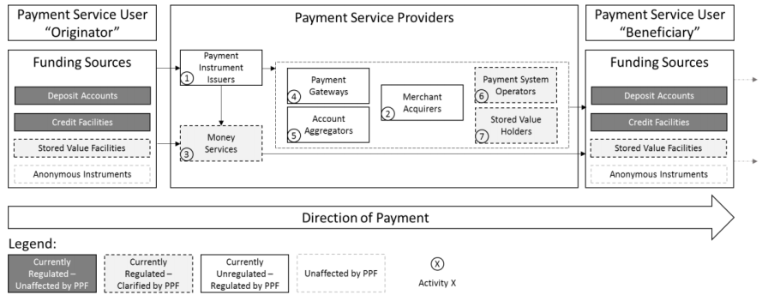
Regulations
“For clarity, cash and other anonymous instruments, having no identifiable issuer that opens and maintains accounts for users, will not be considered as regulated funding sources or payment instruments.” — MAS Consultation Paper: Proposed Activity-based Payments Framework and Establishment of a National Payments Council

Slide 53
Industry Trends
Risks and responses
Scalability
Centralisation
Regulations
Bitcoin vs Altcoins
Peripheral services

Slide 54
Bitcoin vs Altcoins
Two points of view
Multiple altcoins represent decentralisation and diversity of choice
Multiple altcoins serve to weaken network effects
Bitcoin XT vs Bitcoin Unlimited vs Bitcoin Core
Ethereum Classic vs Ethereum Core
Litecoin, Dogecoin, Peercoin …
Merged mining

Slide 55
Industry Trends
Risks and responses
Scalability
Centralisation
Regulations
Bitcoin vs Altcoins
Peripheral services

Slide 56
Peripheral services
Blockchain-as-a-Service
Microsoft Azure, IBM Blockchain, Deloitte Rubix
Cryptocurrency exchanges/Wallets
CoinHako, Coinbase, itBit, Kraken
Blockchain consulting
PwC, Accenture, Chainsmiths

Slide 57
Future Direction
A blockchain strategy
Public vs private blockchains
Blockchain consultants
Strategic positioning
Conclusion

Slide 58
Public vs private blockchains
Public blockchains
Open source
Higher hashing power
Usually associated with a currency of value
Private blockchains
Proprietary
Some aren’t even blockchains, just distributed ledgers (eg. Hyperledger)

Slide 59
Future Direction
A blockchain strategy
Public vs private blockchains
Blockchain consultants
Strategic positioning
Conclusion

Slide 60
Blockchain consultants
Blockchain technology is still nascent
New developments every day; several theoretical topics discussed here are whitepapers and have not made it to peer-reviewed scientific journals.
Unpredictable nature means that consultants cannot give you a clear guideline on what needs to be done
Their primary goal is to help you to develop a blockchain strategy
Allow room for exploration
Minimise risks

Slide 61
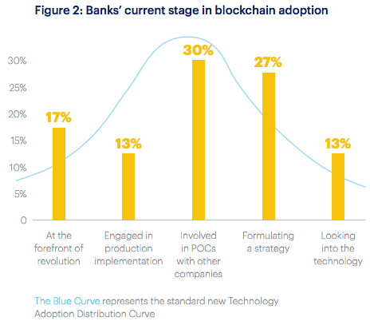
Blockchain consultants
Source: Accenture - Block Chain Technology: How Banks are Building a Real-Time Global Network, Oct 2016

Slide 62
Future Direction
A blockchain strategy
Public vs private blockchains
Blockchain consultants
Strategic positioning
Conclusion

Slide 63
Strategic positioning
Although it’s not possible to make perfect predictions, we can still get an edge over the competition.
Position yourself relatively better than peers to take advantage of improvements in blockchain technology
Acquire clients that rely on blockchain services
Keep up to date with government regulations about cryptocurrency for Singapore as well as for trading partners
Joining a consortium

Slide 64
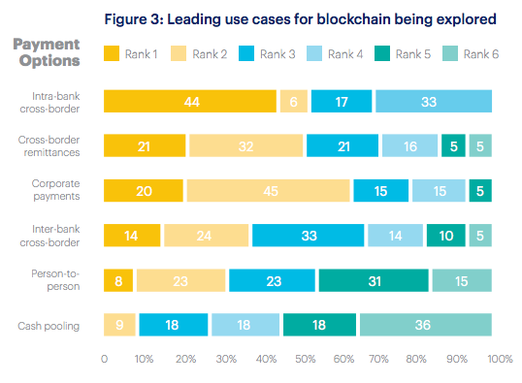
Strategic positioning
Source: Accenture - Block Chain Technology: How Banks are Building a Real-Time Global Network, Oct 2016

Slide 65
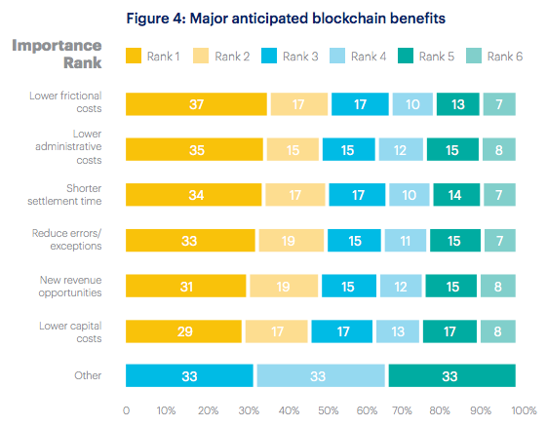
Strategic positioning
Source: Accenture - Block Chain Technology: How Banks are Building a Real-Time Global Network, Oct 2016

Slide 66
Future Direction
A blockchain strategy
Public vs private blockchains
Blockchain consultants
Strategic positioning
Conclusion

Slide 67
Conclusion
Cryptocurrencies and blockchains are very new technologies
Like all new technologies, they are uncertain and potentially disruptive
Over the next few years, we are likely to see more global standards being adopted as regulatory frameworks start to catch up

Slide 68
Conclusion
My own opinions:
Public blockchains are more likely to dominate over private ones
Tiered protocol layers are likely to emerge, with increased adoption
Blockchain and cryptocurrencies are still undergoing rapid development
Makes more sense to build up expertise and prepare for opportunities than to invest in building your own blockchain solution
Key players are governments, miners, and protocol developers
What they do will shape the future direction of blockchains and cryptocurrencies

Slide 69
Q&A

Slide 70
Hashing

Slide 71
Hashing
Gettysburg Address: “Four score and seven years ago …” (272 words)
MD5 hash => aa211716deaeb31a39957980c1cffb8b
SHA1 hash => 6046db27576c8101cf680a631ae0b6229a979066
Converts some input into a random output
This random output is always the same, for any given input
The output is always of a fixed length
You cannot recover the original text from the hash

Slide 72
Public Key Cryptography

Slide 73
Public Key Cryptography
Imagine a box with two keys
A private key that can only from A => B => C
A public key that can only turn from C => B => A
Encrypted messages
Digital Signature
Source: https://medium.com/@vrypan/explaining-public-key-cryptography-to-non-geeks-f0994b3c2d5#.519i0cwhw

